Slide 1
Greedy algorithm
Do you remember the story of monkey picking maize?

Slide 2
7.1 Main idea
Algorithms for optimization problems typically go through a sequence of steps, with a set of choices at each step.
A greedy algorithm always makes the choice that looks best at the moment.
Greedy algorithm makes a locally optimal choice in the hope that this choice will lead to a globally optimal solution.
  Everyday examples:
    Playing cards
    Invest on stocks
    Choose a university

Slide 3
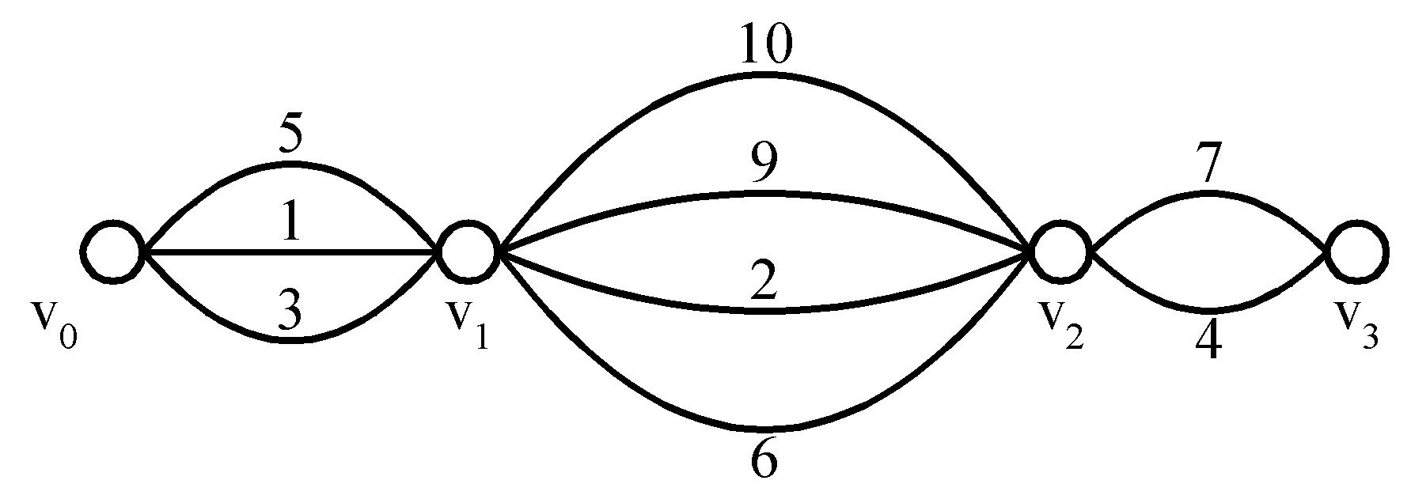
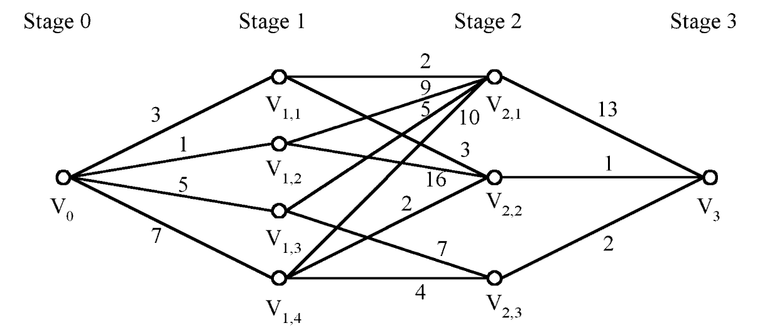
Optimal
Local Optimal

Slide 4
7.2 An activity-selection problem
Problem
Suppose we have a set S = {a₁, a₂, ..., a_{n}} of n proposed activities that wish to use a resource, which can be used by only one activity at a time.
Each activity a_{i} has a start time s_{i} and a finish time f_{i}, where 0≤s_{i}< f_{i} <∞. If selected, activity a_{i} takes place during the half-open time interval [s_{i}, f_{i}).
Activities a_{i} and a_{j} are compatible if the intervals [s_{i}, f_{i}) and [s_{j} , f_{j}) do not overlap.
The activity-selection problem is to select a maximum-size subset of mutually compatible activities.

Slide 5
Activity Selection
Schedule n activities that require exclusive use (专用) of a common resource
S = {a₁, . . . , a_{n}} – set of activities
a_{i} needs resource during period [s_{i} , f_{i})
  s_{i} = start time and f_{i} = finish time of activity a_{i}
  0 ≤ s_{i} < f_{i} < ∞
Activities a_{i} and a_{j} are compatible if the intervals [s_{i} , f_{i}) and [s_{j}, f_{j}) do not overlap
f_{i} ≤ s_{j}
or
f_{j} ≤ s_{i}
i
j
j
i

Slide 6
Activity Selection Problem
Select the largest possible set of nonoverlapping (mutually compatible) activities.
For example,
i | 1 | 2 | 3 | 4 | 5 | 6 | 7 | 8 | 9 | 10 | 11
s_{i} | 1 | 3 | 0 | 5 | 3 | 5 | 6 | 8 | 8 | 2 | 12
f_{i} | 4 | 5 | 6 | 7 | 8 | 9 | 10 | 11 | 12 | 13 | 14
Activities are sorted in increasing order of finish times
A subset of mutually compatible activities: {a₃, a₉, a₁₁}
Maximal set of mutually compatible activities:
{a₁, a₄, a₈, a₁₁} and {a₂, a₄, a₉, a₁₁}

Slide 7

Optimal Substructure
Define the space of subproblems:
S_{ij} = { a_{k} ∈ S : f_{i} ≤ s_{k} < f_{k} ≤ s_{j} }
  activities that start after a_{i} finishes and finish before a_{j} starts
Activities that are compatible with the ones in S_{ij}
  All activities that finish by f_{i}
  All activities that start no earlier than s_{j}

Slide 8
Representing the Problem
Add fictitious activities
  a₀ = [-∞, 0)
  a_{n+1} = [∞, “∞ + 1”)
  Range for S_{ij} is 0 ≤ i, j ≤ n + 1
In a set S_{ij} we assume that activities are sorted in increasing order of finish times:
f₀ ≤ f₁ ≤ f₂ ≤ … ≤ f_{n} < f_{n+1}
What happens if i ≥ j ?
  For an activity a_{k} ∈ S_{ij}: f_{i} ≤ s_{k} < f_{k} ≤ s_{j} < f_{j}
  contradiction with f_{i} ≥ f_{j}!
  ⇒ S_{ij} = ∅ (the set S_{ij} must be empty!)
We only need to consider sets S_{ij} with 0 ≤ i < j ≤ n + 1
S = S_{0(n+1)} entire space of activities

Slide 9
Optimal Substructure
Subproblem:
  Select a maximum size subset of mutually compatible activities from set S_{ij}
Assume that a solution to the above subproblem includes activity a_{k} (S_{ij} is non-empty)
Solution to S_{ij} = (Solution to S_{ik}) ∪ {a_{k}} ∪ (Solution to S_{kj})
⎜Solution to S_{ij} ⎜= ⎜Solution to S_{ik} ⎜+ 1 + ⎜Solution to S_{kj} ⎜
S_{ij}
S_{ik}
S_{kj}

Slide 10
Optimal Substructure
A_{ij}
A_{ik}
A_{kj}
A_{ij} = Optimal solution to S_{ij}
Claim: Sets A_{ik} and A_{kj} must be optimal solutions
Assume ∃ A_{ik}’ that includes more activities than A_{ik}
Size[A_{ij}’] = Size[A_{ik}’] + 1 + Size[A_{kj}] > Size[A_{ij}]
⇒ Contradiction: we assumed that A_{ij} is the maximum # of activities taken from S_{ij}

Slide 11
Recursive Solution
Any optimal solution (associated with a set S_{ij}) contains within it optimal solutions to subproblems S_{ik} and S_{kj}
c[i, j] = size of maximum-size subset of mutually compatible activities in S_{ij}
If S_{ij} = ∅ ⇒ c[i, j] = 0 (i ≥ j)

Slide 12
Recursive Solution
S_{ij}
S_{ik}
S_{kj}
If S_{ij} ≠ ∅ and if we consider that a_{k} is used in an optimal solution (maximum-size subset of mutually compatible activities of S_{ij})
c[i, j] = c[i,k] + c[k, j] + 1

Slide 13
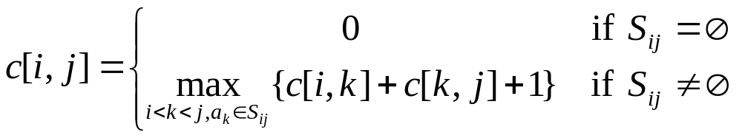
Recursive Solution
There are j – i – 1 possible values for k
  k = i+1, …, j – 1
  a_{k} cannot be a_{i} or a_{j} (from the definition of S_{ij})
  S_{ij} = { a_{k} ∈ S : f_{i} ≤ s_{k} < f_{k} ≤ s_{j} }
  We check all the values and take the best one
We could now write a dynamic programming algorithm

Slide 14
Theorem
Theorem Let S_{ij} ≠ ∅ and a_{m} be the activity in S_{ij} with the earliest finish time:
f_{m} = min { f_{k}: a_{k} ∈ S_{ij} }
Then:
a_{m} is used in some maximum-size subset of mutually compatible activities of S_{ij}
  There exists some optimal solution that contains a_{m}
S_{im} = ∅, so that choosing a_{m} leaves S_{mj} the only nonempty subproblem

Slide 15
Proof
Assume ∃ a_{k} ∈ S_{im}
f_{i} ≤ s_{k} < f_{k} ≤ s_{m} < f_{m}
⇒ f_{k} < f_{m} contradiction !
a_{m} did not have the earliest finish time
⇒ There is no a_{k} ∈ S_{im} ⇒ S_{im} = ∅
S_{ij}
a_{k}
s_{m}
f_{m}
S_{im}
a_{m}
S_{mj}

Slide 16
Proof
a_{m} is used in some maximum-size subset of mutually compatible activities of S_{ij}
A_{ij} = optimal solution for activity selection from S_{ij}
  Order activities in A_{ij} in increasing order of finish time
  Let a_{k} be the first activity in A_{ij} = {a_{k}, …}
If a_{k} = a_{m} Done!
Otherwise, replace a_{k} with a_{m} (resulting in a set A_{ij}’)
  since f_{m} ≤ f_{k} the activities in A_{ij}’ will continue to be compatible
  A_{ij}’ will have the same size with A_{ij} ⇒ a_{m} is used in some maximum-size subset
S_{ij}
s_{m}
a_{m}
f_{m}
a_{k}
f_{k}

Slide 17
Why is the Theorem Useful?
 | Dynamic programming | Using the theorem
Number of subproblems in the optimal solution
Number of choices to consider
2 subproblems:
S_{ik}, S_{kj}
1 subproblem: S_{mj}
S_{im} = ∅
1 choice: the activity
with the earliest
finish time in S_{ij}
j – i – 1 choices
Making the greedy choice (the activity with the earliest finish time in S_{ij})
  Reduce the number of subproblems and choices
  Solve each subproblem in a top-down fashion

Slide 18
Greedy Approach
To select a maximum size subset of mutually compatible activities from set S_{ij}:
  Choose a_{m} ∈ S_{ij} with earliest finish time (greedy choice)
  Add a_{m} to the set of activities used in the optimal solution
  Solve the same problem for the set S_{mj}
From the theorem
  By choosing a_{m} we are guaranteed to have used an activity included in an optimal solution
    ⇒ We do not need to solve the subproblem S_{mj} before making the choice!
  The problem has the GREEDY CHOICE property

Slide 19
Characterizing the subproblems
The original problem: find the maximum subset of mutually compatible activities for S = S_{0, n+1}
Activities are sorted by increasing finish time
a₀, a₁, a₂, a₃, …, a_{n+1}
We always choose an activity with the earliest finish time
  Greedy choice maximizes the unscheduled time remaining
  Finish time of activities selected is strictly increasing

Slide 20
A recursive greedy algorithm
a_{m}
f_{m}
a_{m}
f_{m}
RecursiveTaskSelect(s, f, i, j)
1 m ← i + 1
2 while m < j and s_{m} < f_{i} do //Find first activity in S_{ij}
3 m ← m + 1
4 if m < j then return {a_{m}} ∪RecursiveTaskSelect(s, f, m, j)
5 else return ∅
Activities are ordered in increasing order of finish time
Running time:
Θ(n) – each activity is examined only once
Initial call: RecursiveActivitySelect(s, f, 0, n+1)
a_{m}
f_{m}
a_{i}
f_{i}

Slide 21
i a₀ s_{i} f_{i a}
k s_{k} f_{k}
0 - 0
1 1 4
2 3 5
3 0 6
4 5 7
5 3 8
6 5 9
7 6 10
8 8 11
9 8 12
10 2 13
11 12 14
12 ∞ -
a₀
m=1
a₂
a₁
a₃
a1
a4
a1
m=4
a5
a1
a4
a6
a1
a4
a7
a1
a4
a8
a1
a4
m=8
a9
a1
a4
a8
a10
a1
a4
a8
a11
a1
a4
a8
m=11
a1
a4
a8
a11
0
1
2
3
4
5
6
7
8
9
10
11
12
13
14

Slide 22
An iterative greedy algorithm
GreedyTaskSelect(s, f)
1 A ← {a₁}
2 i ← 1
3 for m ← 2 to n do
4 if s_{m} ≥ f_{i} then //activity a_{m} is compatible with a_{i}
5 A ← A ∪ {a_{m}}
6 i ← m // a_{i} is most recent addition to A
7 return A
Assumes that activities are ordered in increasing order of finish time
Running time: Θ(n) – each activity is examined only once
a_{m}
f_{m}
a_{m}
f_{m}
a_{m}
f_{m}
a_{i}
f_{i}

Slide 23
Steps toward Our Greedy Solution
Determine the optimal substructure of the problem
Develop a recursive solution
Prove that one of the optimal choices is the greedy choice
Show that all but one of the subproblems resulted by making the greedy choice are empty
Develop a recursive algorithm that implements the greedy strategy
Convert the recursive algorithm to an iterative one

Slide 24
Designing Greedy Algorithms
Cast the optimization problem as one for which:
we make a choice and are left with only one subproblem to solve
Prove that there is always an optimal solution to the original problem that makes the greedy choice
  Making the greedy choice is always safe
Demonstrate that after making the greedy choice:
the greedy choice + an optimal solution to the resulting subproblem leads to an optimal solution

Slide 25
Correctness of greedy algorithms
Greedy choice property
  A globally optimal solution can be arrived at by making a locally optimal (greedy) choice
Optimal substructure property
  We know that we have arrived at a subproblem by making a greedy choice
  Optimal solution to subproblem + greedy choice ⇒ optimal solution for the original problem

Slide 26
Activity Selection
Greedy Choice Property
  There exists an optimal solution that includes the greedy choice: The activity a_{m} with the earliest finish time in S_{ij}
Optimal Substructure:
If an optimal solution to subproblem S_{ij} includes activity a_{m} ⇒ it must contain optimal solutions to S_{im} and S_{mj}, Similarly, a_{m} + optimal solution to S_{im} ⇒ optimal solution.

Slide 27
DP vs. greedy algorithms
Dynamic programming
  We make a choice at each step
  The choice depends on solutions to subproblems
  Bottom up solution, from smaller to larger subproblems
Greedy algorithm
  Make the greedy choice and THEN
  Solve the subproblem arising after the choice is made
  The choice we make may depend on previous choices, but not on solutions to subproblems
  Top down solution, problems decrease in size
Common: Optimal substructure

Slide 28
7.3 The Knapsack Problem
The 0-1 knapsack problem
  A thief rubbing a store finds n items: the i-th item is worth v_{i} dollars and weights w_{i} pounds (v_{i}, w_{i} integers)
  The thief can only carry W pounds in his knapsack
  Items must be taken entirely or left behind
  Which items should the thief take to maximize the value of his load?
The fractional knapsack problem
  Similar to above
  The thief can take fractions of items

Slide 29
Fractional Knapsack Problem
Knapsack capacity: W
There are n items: the i-th item has value v_{i} and weight w_{i}
Goal:
  find x_{i} such that for all 0 ≤ x_{i} ≤ 1, i = 1, 2, .., n
  ∑ w_{i}x_{i} ≤ W and
  ∑ x_{i}v_{i} is maximum

Slide 30
Fractional Knapsack Problem
Greedy strategy 1:
  Pick the item with the maximum value
For example
  W = 1
  w₁ = 100, v₁ = 2
  w₂ = 1, v₂ = 1
  Taking from the item with the maximum value:
  Total value taken = v₁/w₁ = 2/100
  Smaller than what the thief can take if choosing the other item
  Total value (choose item 2) = v₂/w₂ = 1

Slide 31
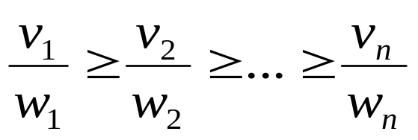
Fractional Knapsack Problem
Greedy strategy 2:
  Pick the item with the maximum value per pound v_{i}/w_{i}
  If the supply of that element is exhausted and the thief can carry more: take as much as possible from the item with the next greatest value per pound
  It is good to order items based on their value per pound

Slide 32

Fractional Knapsack Problem
Greedy2Knapsack(W, v)
1 order items based on their value per pound
2 i ← 1; w ← W
3 while w > 0 and as long as there are items remaining do
4 x_{i} ← min {1, w/w_{i}}
5 remove item i from list
6 w ← w – x_{i}w_{i}
7 i ← i+1
w – the amount of space remaining in the knapsack (w = W)
Running time: Θ(n) if items already ordered; else Θ(nlgn)

Slide 33
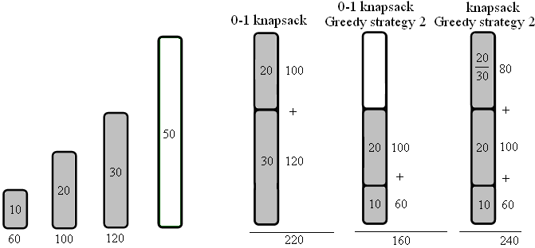
Knapsack - Example
For example

Slide 34
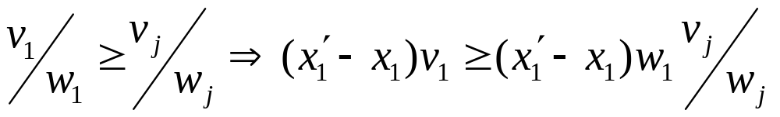
Greedy Choice
Items: 1 2 3 … j … n
Optimal solution: x₁ x₂ x₃ x_{j} x_{n}
Greedy solution: x₁’ x₂’ x₃’ x_{j}’ x_{n}’
We know that: x₁’ ≥ x₁
  greedy choice takes as much as possible from item 1
Modify the optimal solution to take x₁’ of item 1
  We have to decrease the quantity taken from some item j: the new x_{j} is decreased by: (x₁’ - x₁) w₁/w_{j}
Increase in profit: (x₁’ - x₁) v₁
Decrease in profit:(x₁’ - x₁)w₁/w_{j} v_{j}

Slide 35
Optimal Substructure
Consider the most valuable load that weights at most W pounds
If we remove a weight w of item j from the optimal load
The remaining load must be the most valuable load weighing at most W – w that can be taken from the remaining n – 1 items plus w_{j} – w pounds of item j

Slide 36
0-1 Knapsack - Greedy Strategy
None of the solutions involving the greedy choice (item 1) leads to an optimal solution
  The greedy choice property does not hold

Slide 37
7.4 Data Compression (Huffman codes)
Data compression problem – strings S and S’:
  S -> S’ -> S, such that |S’|<|S|
Huffman codes are a widely used and very effective technique for compressing data; savings of 20% to 90% are typical, depending on the characteristics of the data being compressed.
We consider the data to be a sequence of characters. Huffman's greedy algorithm uses a table of the frequencies of occurrence of the characters to build up an optimal way of representing each character as a binary string.

Slide 38
Data Compression (Huffman codes)
A character-coding problem. A data file of 100,000 characters contains only the characters a–f, with the frequencies:
How much do we save in this case?
  Fixed-length code: 100,000×3=300,000
  Variable-length code: (45×1 + 13×3 + 12×3 + 16×3 + 9×4 + 5×4) ×1,000 = 224,000 bits
 | a | b | c | d | e | f
Frequency | 45 | 13 | 12 | 16 | 9 | 5
Fixed-length codeword | 000 | 001 | 010 | 011 | 100 | 101
Variable-length codeword | 0 | 101 | 100 | 111 | 1101 | 1100

Slide 39
Prefix codes: no codeword is also a prefix of some other codeword.
  It can be shown that optimal coding can be done with prefix code
Encoding: concatenate the codewords
representing each character of the file.
abc→0·101·100 → 0101100.
Prefix codes are desirable because they simplify decoding.
001011101→ 0· 0·101·1101→ aabe.

Slide 40
The decoding process needs a convenient representation for the prefix code so that the initial codeword can be easily picked off.
A binary tree whose leaves are the given characters provides one such representation.
Interpret the binary codeword for a character as the path from the root to that character, where 0 means "go to the left child" and 1 means "go to the right child.", then we can construct a binary tree corresponding to the coding schemes.

Slide 41
The optimal prefix code
100
0
1
86
14
0
1
0
58
28
14
0
1
0
1
0
1
a:45
b:13
c:12
d:16
e:9
f:5

Slide 42
The optimal prefix code
100
0
1
a:45
55
0
1
25
30
0
1
0
1
c:12
b:13
14
d:16
0
1
f:5
e:9

Slide 43

Given a tree T corresponding to a prefix code, it is a simple matter to compute the number of bits required to encode a file. For each character c in the alphabet C, let f (c) denote the frequency of c in the file and let d_{T}(c) denote the depth of c's leaf in the tree. Note that d_{T}(c) is also the length of the codeword for character c. The number of bits required to encode a file is thus
which we define as the cost of the tree T.

Slide 44
Huffman Algorithm - Idea
Huffman algorithm, builds the codeword bottom up. Consider a forest of trees:
  Initially – one separate node for each character.
  In each step – join two trees into a larger tree
A+B
0
1
A
B
A
B
  Repeat this until one tree (trie) remains.
  Which trees to join? Greedy choice – the trees with the smallest frequencies!

Slide 45
Constructing a Huffman code
HuffmanCode(C)
1 Q ← C
2 for i ← 1 to n - 1 do
3 allocate a new node z
4 x ← ExtractMin(Q)
5 y ← ExtractMin(Q)
6 f (z) ← f (x) + f (y)
7 Insert(Q, z)
8 return ExtractMin(Q) //Return the root of the tree.

Slide 46
Constructing a Huffman Tree
f:5
e:9
c:12
b:13
d:16
a:45

Slide 47
Constructing a Huffman Tree
14
c:12
b:13
d:16
a:45
0
1
f:5
e:9

Slide 48
Constructing a Huffman Tree
14
d:16
25
a:45
0
1
0
1
f:5
e:9
c:12
b:13

Slide 49
Constructing a Huffman Tree
30
25
a:45
0
1
0
1
14
d:16
c:12
b:13
0
1
f:5
e:9

Slide 50
Constructing a Huffman Tree
a:45
55
0
1
25
30
0
1
0
1
c:12
b:13
14
d:16
0
1
f:5
e:9

Slide 51
Constructing a Huffman Tree
100
0
1
a:45
55
0
1
25
30
0
1
0
1
c:12
b:13
14
d:16
0
1
f:5
e:9

Slide 52
Correctness of Huffman's algorithm
Theorem 7.4 Let C be an alphabet in which each character c∈C has frequency f (c). Let x and y be two characters in C having the lowest frequencies. Then there exists an optimal prefix code for C in which the codewords for x and y have the same length and differ only in the last bit.
Proof:

Slide 53
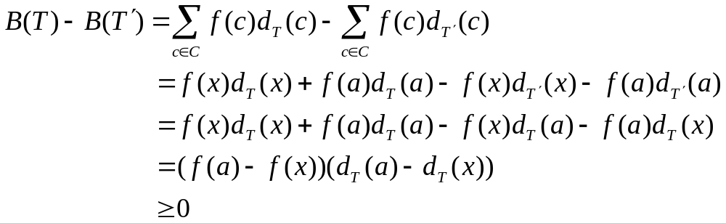
T
T ′
T〞
x
a
a
y
y
b
a
b
x
b
x
y

Slide 54
so B(T') ≤ B(T), similarly,we have
B(T") ≤ B(T') , so B(T") ≤ B(T) , and since T is optimal,B(T) ≤ B(T"), which implies B(T") =B(T).
This lemma shows that the problem of constructing optimal prefix codes has Greedy-choice property. The next lemma shows that the problem of constructing optimal prefix codes has the optimal substructure property.

Slide 55
Theorem 7.5 The conditions is the same as Theorem 7.4 . Let C' be the alphabet C with characters x, y removed and (new) character z added, so that C' = {C - {x, y}}∪{z}; define f for C' as for C, except that f(z) = f(x) + f(y). Let T' be any tree representing an optimal prefix code for the alphabet C' . Then the tree T, obtained from T' by replacing the leaf node for z with an internal node having x and y as children, represents an optimal prefix code for the alphabet C.

Slide 56
Proof Let B(T) and B(T’) be the cost of tree T and T’, then
f(x)d_{T}(x) + f(y)d_{T}(y)
= (f(x)+ f(y))(d'(z) +1)
= f(z)d'(z) + (f(x)+ f(y)),
so B(T) = B(T') + f(x)+ f(y)
Suppose that T does not represent an optimal
prefix code for C . Then there exists a tree T" such that B(T" ) < B(T). Let z is the parent of x and y with frequency f(z)= f(x)+ f(y), thus we can construct a tree T''' from T". Then

Slide 57
B(T''') = B(T'') + f(x) + f(y) and since B(T) = B(T') + f(x) + f(y), and B(T″) < B(T),
so B(T''') <B(T), yielding a contradiction to T is an optimal prefix code for C. Thus T' represents an optimal prefix code for C' .
Therefore Procedure HUFFMAN produces an optimal prefix code.

Slide 58
Experiment for activity selection problem
Table 7.1 Running-time comparison of algorithms for activity selection problem
n | 100 | 200 | 400 | 600 | 800 | 1000
Dynamic programming(DP) | 0.000 | 0.015 | 0.189 | 0.656 | 1.656 | 3.250
RecursiveTaskSelect(RTS) | 0.000 | 0.000 | 0.000 | 0.000 | 0.000 | 0.000
GreeyTaskSelect(GTS) | 0.000 | 0.000 | 0.000 | 0.000 | 0.000 | 0.000
Maximum task number | 19 | 24 | 30 | 40 | 46 | 52

Slide 59
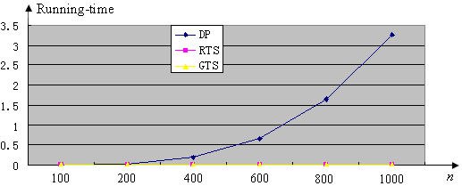

Slide 60
Homework
Page 109-111
  7.2
  7.5
  7.8
  7.15
  7.16 和7.17至少选做2题

Slide 61
贪心算法实验课程设计

Slide 62
如何使广告的收益最大化？
Google的AdWords,或者其他搜索引擎的关键定广告，使用的基本都是“关键字竞价”（或者称“关键字拍卖”）的机制，对每个用户搜索的关键定，挑选为它竞价的广告来显示。
用户搜索的关键字到达搜索引擎次序无法预知，每个竞价者为一个关键字出的价钱也千差万别，竞价者还会对每天的花费总额有一个封顶的预算，超过了这个预算，即使有合适的关键字，竞价者也不希望为它多花钱了。
搜索引擎们是通过什么样的规则来安排哪个广告给哪个关键字，以最大化当天的收益的呢？

Slide 63
问题表述：
有N个关键字竞价者，每个竞价者指定了一个最大预算bi.
Q是一个关键字的集合。
每个竞价者i对一个关键字q∈Q,指定一个出价Ciq.
竞价开始后，关键字序列q1，q2….qM(qj∈Q)实时到达，每个qj必须实时分配给某个竞价者i的广告以赚取收益Ciqj。
问题的目标是：在满足竞价者对关键字匹配要求的基础上，使总收益最大。

Slide 64
要求
请设计出一个贪心算法
程序设计
  任给一个输入实例，能输出总收益。

